Slide 1



Sustainability in your curriculum: identify, improve, inspire!

Slide 2
What’s the first word/phrase that comes to mind when you hear the word ‘sustainability’?
https://www.polleverywhere.com/my/polls
Notes:
What is the first word/phrase that comes to mind when you hear the word 'Sustainability'

Slide 3

the 3 Pillars of Sustainability
Social (People)
Environment (Planet)
Economic (Profit)
Based on “sustainable development” from Wikimedia.org under Creative Commons licensing, and further adapted from United Nations (1987), International Union for Conservation of Nature (IUCN) (2005), Makkar (2013), and Makkar and Ankers (2014).
Image obtained from: https://www.thwink.org/sustain/glossary/ThreePillarsOfSustainability.htm
Notes:
Large amount of you have selected words/phrases relating to the environment) Sustainability is so much more than that. Sustainability in a broader sense covers three main areas, known as pillars. These are Social, Environment and Economic and form the basis for the 17 UN development goals…

Slide 4
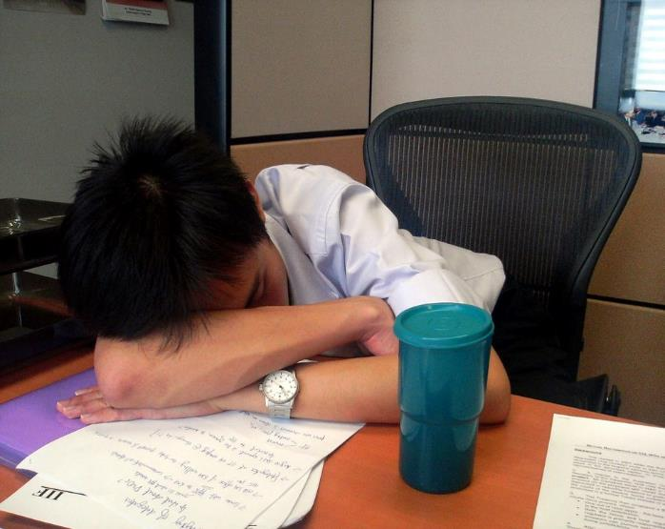

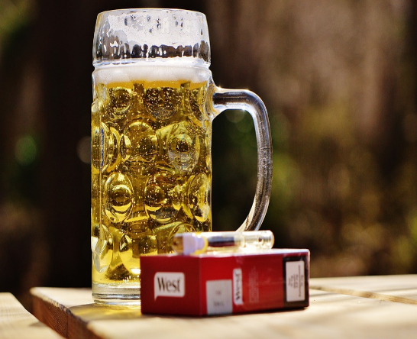
Social
Ability to achieve a social well- being
Treating everyone fairly and with respect
Global citizenship – people have rights and civic responsibilities

Slide 5
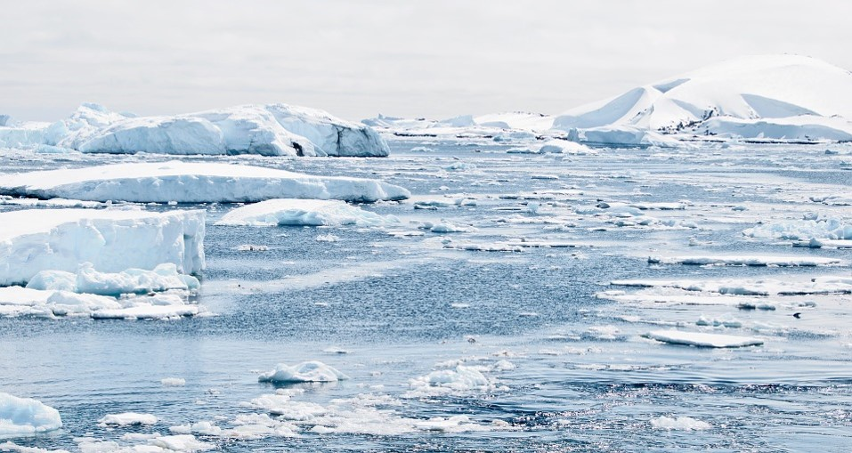
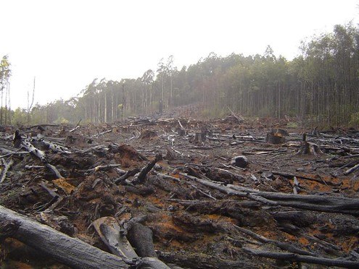
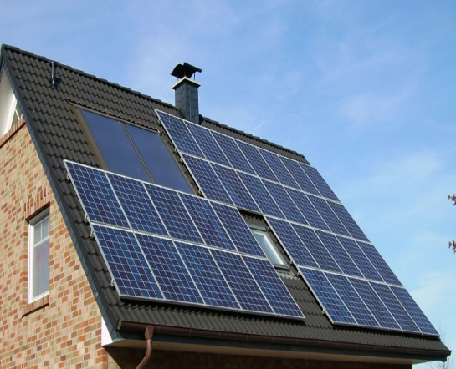
Environment
Living within our means
Natural resources – the need to consider material scarcity and damage to the environment
Extinction of species

Slide 6


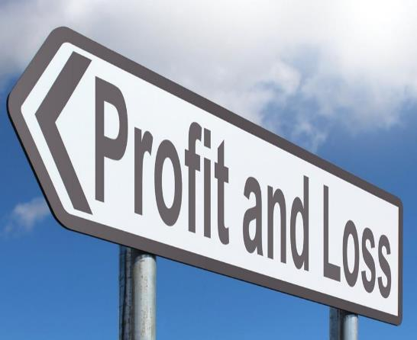
Economic
Business/country uses its resource efficiently and responsibly
Operational profit
Without efficient and effective uses of resources, a business cannot sustain its activities in the long term

Slide 7
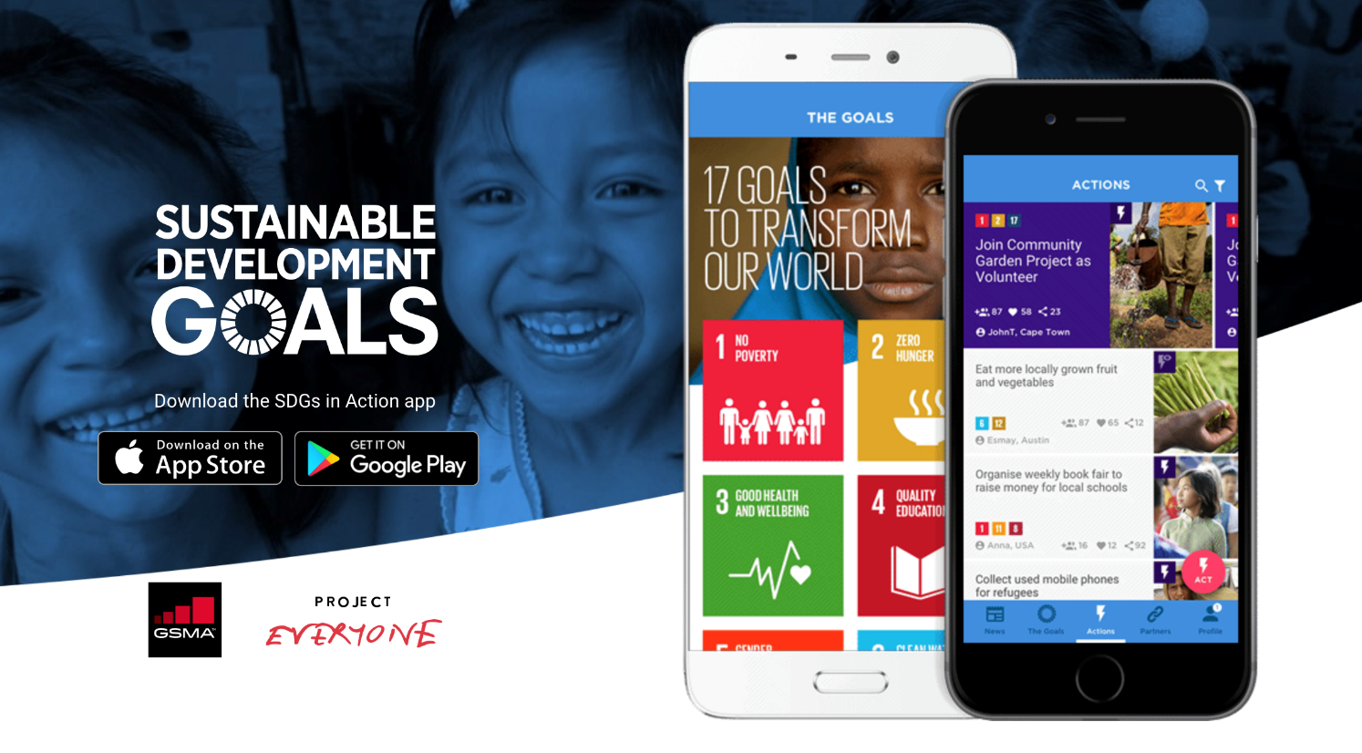
the UN Sustainable Development Goals
Notes:
These goals were created in 2015 with the aim of achieving each of them by 2030. Sustainability relating to curriculum transformation at the university is based on these 17 goals, with each of them falling in at least one of the 3 pillars of sustainability. (Read out each of the goals) Link them to the SDGs in Action App

Slide 8

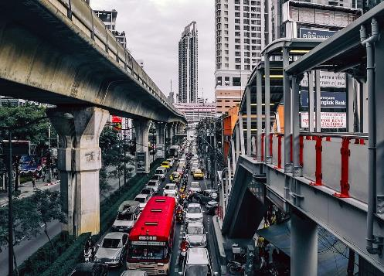
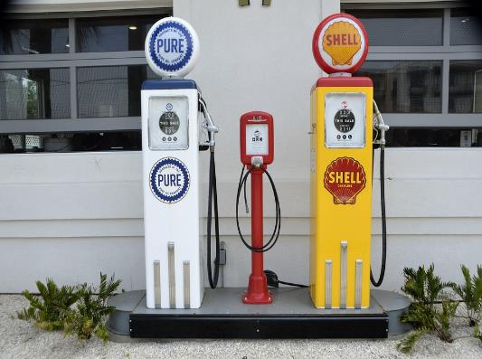
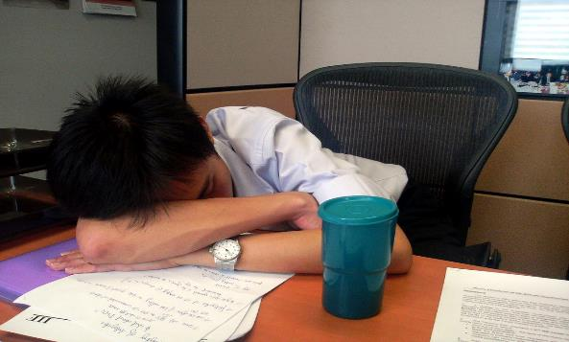
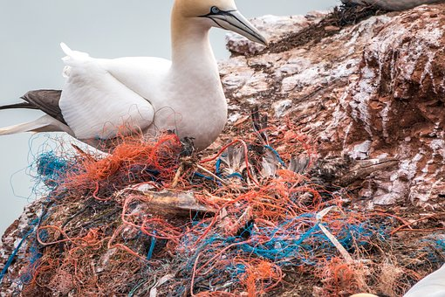
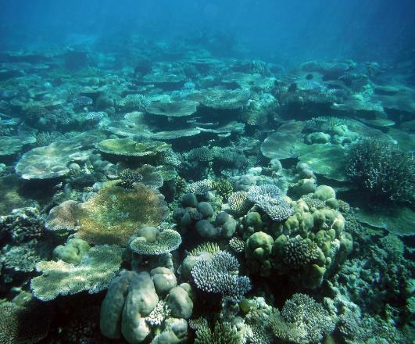

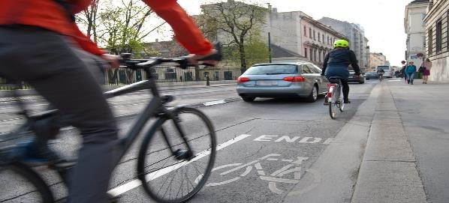
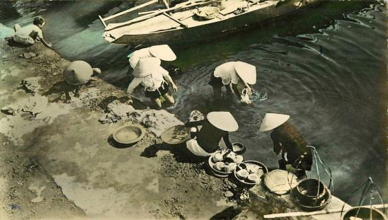
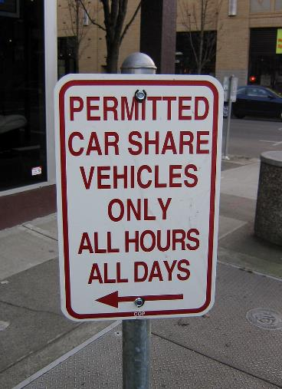

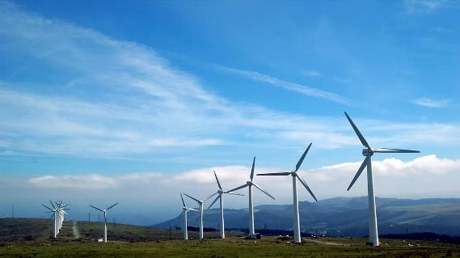
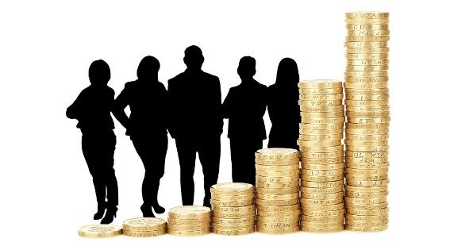
Notes:
Tables containing images asking ‘Is this sustainable?’ Images range from a personal level to a world wide issue. Ask what could be done to make the image more sustainable? And which one of the Sustainable development goals it relates to? This will allow students to gain a better understanding of each of the goals. Are they social, economic, environmental? Mixture of more than one?
Population graph: Source: Allianz SE; United Nations World Population Prospects, Deutsche Stiftung Weltbevölkerung http://knowledge.allianz.com/?799 No alterations have been made to the original image
Dirty water image: "Hué - Lavandières 1953" by manhhai is licensed under CC BY 2.0 No alterations have been made to the original image
Car share sign: "IMG_0606.JPG" by Blue Grama is licensed under CC BY-NC-SA 2.0 No alterations have been made to the original image
"Coral reef" by Jen R is licensed under CC BY-NC-ND 2.0 No alterations have been made to the original image

Slide 9
Is it sustainable?
Does the image represent something sustainable or not sustainable?
What could be done to make the activity more sustainable?
Which of the SDGs does the image relate to?
Does the activity relate to the social, economic or environmental pillars? A mixture of more than 1?

Slide 10




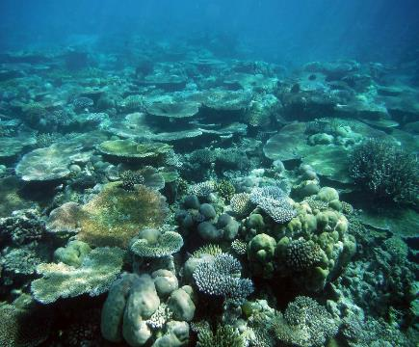



#notsustainable
Notes:
Population graph: Source: Allianz SE; United Nations World Population Prospects, Deutsche Stiftung Weltbevölkerung http://knowledge.allianz.com/?799 No alterations have been made to the original image
Dirty water image: "Hué - Lavandières 1953" by manhhai is licensed under CC BY 2.0 No alterations have been made to the original image
"Coral reef" by Jen R is licensed under CC BY-NC-ND 2.0 No alterations have been made to the original image

Slide 11
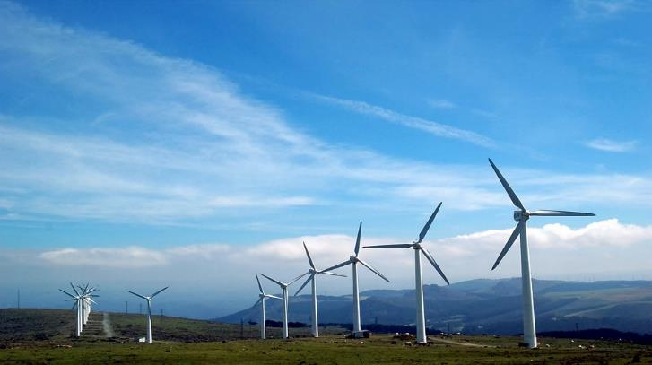



#sustainable
Notes:
Car share sign: "IMG_0606.JPG" by Blue Grama is licensed under CC BY-NC-SA 2.0 No alterations have been made to the original image

Slide 12
- Ways in which sustainability is already embedded in your curriculum (If any) - Ways in which you would/could embed sustainability into the curriculum of your course (e.g. Course add-ons, coursework based on a world wide issue, guest lecturers, projects etc.)
Activity: In groups think of…
Notes:
Introduce the main activity of the workshop – With this definition of sustainability in mind, in groups, think of ways in which sustainability is already incorporated into the curriculum in your course (if any) and ways you would embed sustainability into the curriculum of your course.

Slide 13
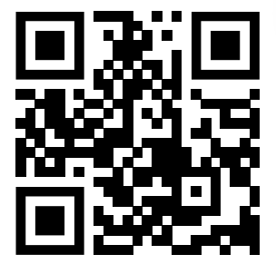
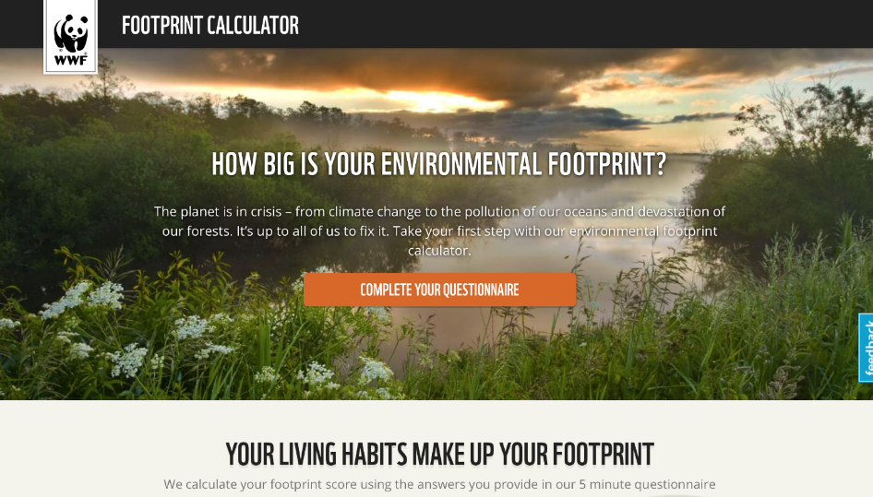
‘Am I environmentally sustainable?'
https://footprint.wwf.org.uk
Notes:
Am I Sustainable activity – QR code linked to the WWF carbon footprint calculator.

Slide 14
Dawes, M., Angus-Cole, K., and Eaton, R. (2019) Sustainability in your curriculum - identify, improve, inspire! Centre for Learning and Teaching, University of Bath

